Slide 1
Mass Spectronomer

Slide 2
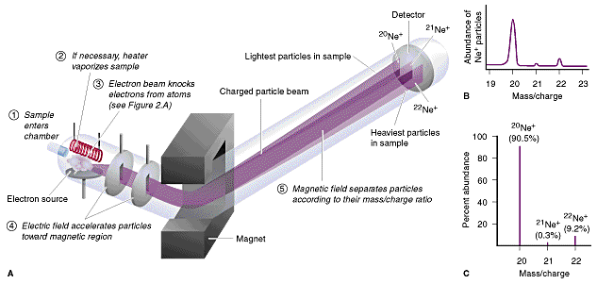
Mass Spectrometer
http://www.magnet.fsu.edu/education/tutorials/java/massspectra/index.html

Slide 3
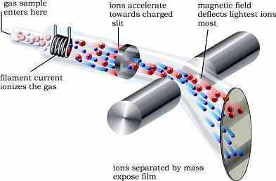
Mass Spectrometer
The mass spectrometer is an instrument used:
To measure the relative masses of isotopes
To find the relative abundance of the isotopes in a sample of an element
When charged particles pass through a magnetic field, the particles are deflected by the magnetic field, and the amount of deflection depends upon the mass/charge ratio of the charged particle.

Slide 4
Mass Spectrometer – 5 Stages
Once the sample of an element has been placed in the mass spectrometer, it undergoes five stages.
Vaporisation – the sample has to be in gaseous form. If the sample is a solid or liquid, a heater is used to vaporise some of the sample.
X _{(s)} → X _{(g)}
or X _{(l)} → X _{(g)}

Slide 5
Mass Spectrometer – 5 Stages
Ionization – sample is bombarded by a stream of high-energy electrons from an electron gun, which ‘knock’ an electron from an atom. This produces a positive ion:
X _{(g)} → X ⁺ _{(g)} + e⁻
Acceleration – an electric field is used to accelerate
the positive ions towards the magnetic field. The
accelerated ions are focused and passed through a
slit: this produces a narrow beam of ions.

Slide 6
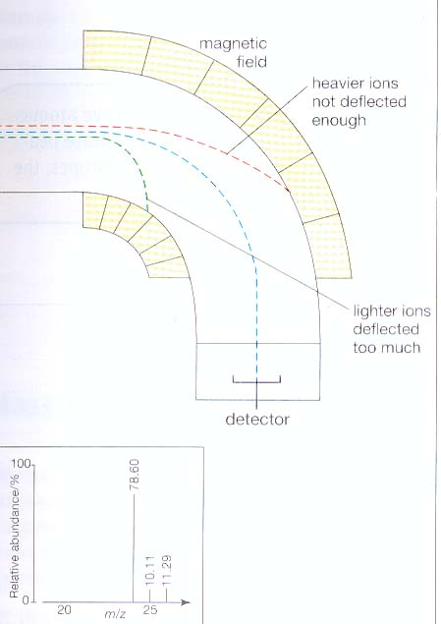
Mass Spectrometer – 5 Stages
Deflection –
The accelerated ions are deflected into the magnetic field. The amount of deflection is greater when:
• the mass of the positive ion is less
• the charge on the positive ion is greater
• the velocity of the positive ion is less
• the strength of the magnetic field is
greater

Slide 7
Mass Spectrometer
If all the ions are travelling at the same velocity and carry the same charge, the amount of deflection in a given magnetic field depends upon the mass of the ion.
For a given magnetic field, only ions with a particular relative mass (m) to charge (z) ration – the m/z value – are deflected sufficiently to reach the detector.

Slide 8
Mass Spectrometer
Detection – ions that reach the detector cause electrons to be released in an ion-current detector
The number of electrons released, hence the current produced is proportional to the number of ions striking the detector.
The detector is linked to an amplifier and then to a recorder: this converts the current into a peak which is shown in the mass spectrum.

Slide 9
Atomic Structure – Mass Spectrometer
Name the five stages which the sample undergoes in the mass spectrometer and make brief notes of what you remember under each stage.
Complete Exercise 4, 5 and 6 in the handbook. Any incomplete work to be completed and handed in for next session.

Slide 10
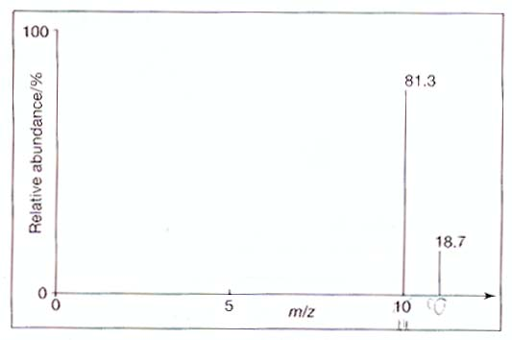
Atomic Structure – Mass Spectrometer
Isotopes of boron
m/z value | 11 | 10
Relative abundance % | 18.7 | 81.3
A_{r} of boron = (11 x 18.7) + (10 x 81.3)
(18.7 + 81.3)
= 205.7 + 813
100
= 1018.7 = 10.2
100

Slide 11
Mass Spectrometer – Questions
A mass spec chart for a sample of neon shows that it contains:
90.9% ²⁰Ne
0.17% ²¹Ne
8.93% ²²Ne
Calculate the relative atomic mass of neon
You must show all your working!

Slide 12
Mass Spectrometer – Questions
90.9% ²⁰Ne
0.17% ²¹Ne
8.93% ²²Ne
(90.9 x 20) + (0.17 x 21) + (8.93 x 22)
100
A_{r}= 20.18

Slide 13
Mass Spectrometer – Questions
Calculate the relative atomic mass of lead
You must show all your working!
52.3
23.6
22.6
1.5
204
206
207
208
m/e

Slide 14
Mass Spectrometer – Questions
1.5% ²⁰⁴Pb
23.6% ²⁰⁶Pb
22.6% ²⁰⁷Pb
52.3% ²⁰⁸Pb
(1.5 x 204) + (23.6 x 206) + (22.6 x 207)+(52.3 x 208)
100
306 + 4861.6 + 4678.2 + 10878.4
100
20724.2
100
A_{r}= 207.24

Slide 15
Simulation
http://www.colby.edu/chemistry/OChem/DEMOS/MassSpec.html

Slide 16
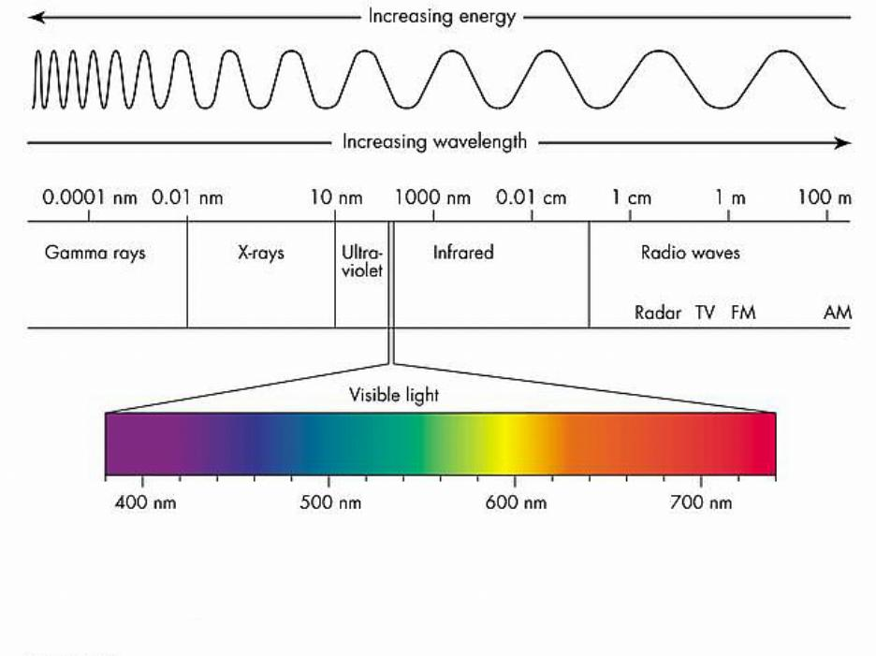
The Electromagnetic Spectrum
High frequency
Short wavelength
High energy
lower frequency
longer wavelength
lower energy

Slide 17
Wave Properties of Matter
Light or electromagnetic radiation may be viewed in one of two complementary ways: as a wave or as a stream of particles
Electromagnetic energy at a particular wavelength λ has an associated frequency ν and energy E. These quantities are related according to the equations:
c = λ ν and E = h ν
Where
c ( speed of light ) = 3×10⁸ m/s)
h (Planck's constant ) = 6.626 × 10⁻³⁴ J·s
http://csep10.phys.utk.edu/astr162/lect/light/waves.html

Slide 18
Exercise
Suppose we have an electromagnetic wave of wavelength 400nm.
a)Calculate its frequency
b)Calculate its energy
2. The yellow light given off by a sodium vapor lamp used for public lighting has a walength of 589 nm.
What is the frequency of radiation ?
What is the amount of energy?

Slide 19
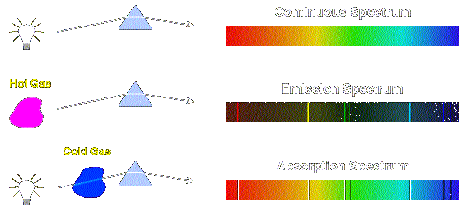
Emission Spectra
Emission spectra: consists of a series of separate discrete lines, which become closer together(converge) towards the high energy end of the spectrum.
Notes:
The emission lines correspond to photons of discrete energies that are emitted when excited atomic states in the gas make transitions back to lower-lying levels.

Slide 20
Emission of Light
When electrons are excited they can move to a higher energy level.
When they move back down they emit energy in the form of light
The color of the light emitted depends on the FREQUENCY
This light forms a LINE SPECTRUM
Bohr Model:
http://www.cs.sbcc.edu/physics/solar/sciencesegment/bohratom.swf

Slide 21
Line Spectra
Because electrons can only exist in certain energy levels, only certain transitions can occur.
e.g. an electron can move from the second energy level (n=2) to the first energy level (n=1).
Each transition emits light of a particular frequency.
Therefore a line spectrum is produced.
A continuous spectrum would suggest that electrons can exist anywhere around the nucleus

Slide 22
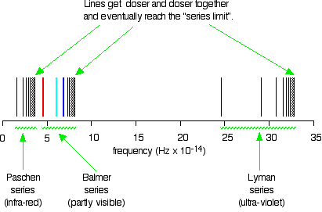
Hydrogen Emission Spectrum

Slide 23
Which Frequencies can be observed?
From n=x to n=1:
These are the transitions that emit the most energy (highest frequency or shortest wavelength), therefore in u.v. range.
N=3→ n=1 emits a higher frequency than n=2 → n=1 etc

Slide 24
Explanation of Emission Spectra
When electrons return to the first level (n=1) the series of lines occurs in the ultraviolet region as this involves the largest energy change.
The visible region spectrum is formed by electrons dropping back to the n=2 level.
The first series in the infrared region is due to electrons falling to the n=3 level.

Slide 25
Notes
Notice that at higher frequencies the lines get closer together (converge)
This indicates that the energy difference between levels becomes less as the level number increases.
In other words: the difference in energy between n=1 and n=2is less than the difference in energy between n=2 and n=3

Slide 26
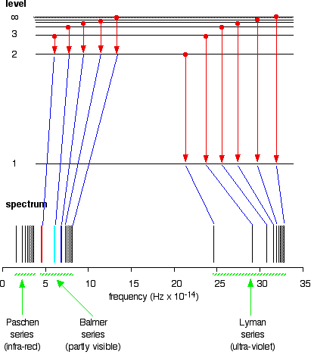

Slide 27
The lower energy part of the spectrum
Represents lower energy transitions
E.g. an electron moving from n=4 to n=3
These energy levels are closer so less energy is emitted.
Convergence is also observed here, e.g lines for n=6 → n=3 will be extremely close to the line for n=7 → n=3
Each series will come to an end with the line for the transition from n = ∞

Slide 28
Some Atomic Emission Spectra
Hydrogen
Mercury
Argon
Helium

Slide 29
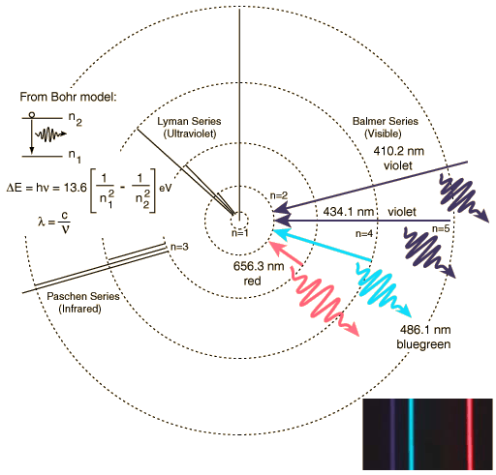
Hydrogen Spectrum

