Slide 1
Kinetics
Factors affecting Rate of Reaction
By Adriana Hartmann

Slide 2
Temperature
As temperature increases, so does the reaction rate.
This is because the rate constant, k, depends on the temperature.
Rough rule of thumb: an increase in 10°c doubles the rate.
2

Slide 3
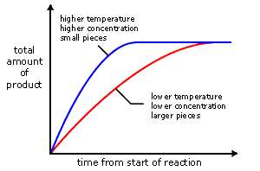
temperature
Higher temperature results in more particles having the necessary activation energy.
This causes more successful collisions

Slide 4
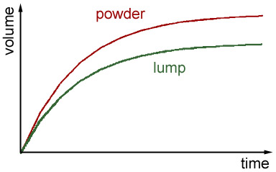
Surface Area
In a solid only surface particles can collide with the reactant.
Powdering increases surface area
The larger surface area increases the reaction rate.

Slide 5
Concentration
More concentration increases collisions per second per unit volume.
As reactants get used up the concentration decreases.
Most reactions slow down as time proceeds

Slide 6
Catalysts
Catalysts increase the rate of a reaction by decreasing the activation energy of the reaction.
Catalysts change the mechanism by which the process occurs.
Some catalysts also make atoms line up in the correct orientation so as to enhance the reaction rate
6.

Slide 7
Catalysts
Catalysts may be either homogeneous or heterogeneous
A homogeneous catalyst is in the same phase as the substances reacting.
A heterogeneous catalyst is in a different phase
7.

Slide 8
Catalysts and Mechanisms
Mechanism with a catalyst
AlCl₃ + Cl₂→ AlCl₄⁻ + Cl^{+ .}
Cl⁺ + C₆H₆ → C₆H₅Cl + H^{+ .}
H⁺ +AlCl₄⁻ → AlCl₃ + HCl.
--------------------------------------------------------------------------------------------------------------------------------------------------------------------------------------------------------
Overall: Cl₂+ C₆H₆ → C₆H₅Cl +HCl
8

Slide 9
Catalysts
One way a catalyst can speed up a reaction is by holding the reactants together and helping bonds to break.
9

Slide 10
Catalysts & Stratospheric Ozone
In the stratosphere, oxygen molecules absorb ultraviolet light and break into individual oxygen atoms known as free radicals
The oxygen radicals can then combine with ordinary oxygen molecules to make ozone.
Ozone can also be split up again into ordinary oxygen and an oxygen radical by absorbing ultraviolet light.
10.

Slide 11
Catalysts & Stratospheric Ozone
The presence of chlorofluorcarbons in the stratosphere can catalyze the destruction of ozone. UV light causes a Chlorine free radical to be released
The chlorine free radical attacks ozone and converts it
Back to oxygen. It is then regenerated to repeat the
Process. The result is that each chlorine free radical can
Repeat this process many many times. The result is that
Ozone is destroyed faster than it is formed, causing its level to drop
11.

Slide 12
Enzymes
Enzymes are catalysts in biological systems.
The substrate fits into the active site of the enzyme much like a key fits into a lock.
12

Slide 13
End

Slide 14
Bibiliography
http://en.wikipedia.org/wiki/Chemical_kinetics
http://www.saskschools.ca/curr_content/chem30_05/2_kinetics/kinetics2_1.htm
Geoffrey Neuss. Chemistry course companion. Bell and Bain Ltd. Glascow, 2007.

