Slide 1
Kinetics
Reaction Mechanisms
By Adriana Hartmann

Slide 2
Reaction Mechanisms
The reaction mechanism is the sequence of events that describes the actual process by which reactants become products is called.
2

Slide 3
Reaction Mechanisms
Reactions may occur all at once or through several discrete steps.
Each of these processes is known as an elementary reaction or elementary process.
3

Slide 4
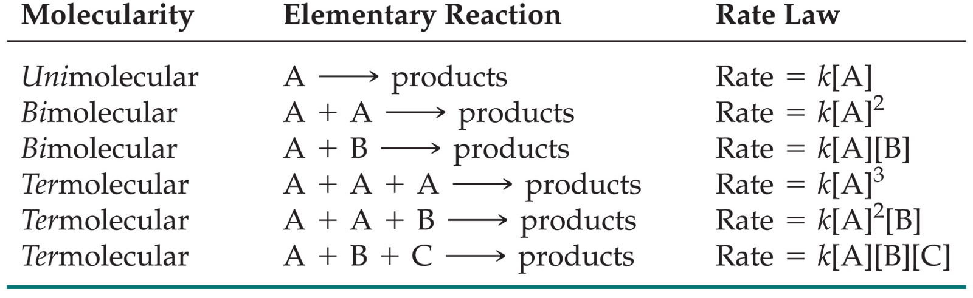
Reaction Mechanisms
The molecularity of a process tells how many molecules are involved in the process.
The rate law for an elementary step is written directly from that step.
4

Slide 5
Multistep Mechanisms
In a multistep process, one of the steps will be slower than all others.
The overall reaction cannot occur faster than this slowest, rate-determining step.
5

Slide 6
Slow Initial Step
NO₂(g) + CO (g)⎯⎯→ NO (g) + CO₂(g)
The rate law for this reaction is found experimentally to be
Rate = k [NO₂]²
CO is necessary for this reaction to occur, but the rate of the reaction does not depend on its concentration.
This suggests the reaction occurs in two steps.
6

Slide 7
Slow Initial Step
A proposed mechanism for this reaction is
Step 1: NO₂ + NO₂⎯⎯→ NO₃ + NO (slow)
Step 2: NO₃ + CO ⎯⎯→ NO₂ + CO₂ (fast)
The NO₃ intermediate is consumed in the second step.
As CO is not involved in the slow, rate-determining step, it does not appear in the rate law.
7

Slide 8
Fast Initial Step
The rate law for this reaction is found (experimentally) to be
Because termolecular (= trimolecular) processes are rare, this rate law suggests a two-step mechanism.
8

Slide 9
Fast Initial Step
A proposed mechanism is
Step 1 is an equilibrium-
it includes the forward and reverse reactions.
9

Slide 10
Fast Initial Step
The rate of the overall reaction depends upon the rate of the slow step.
The rate law for that step would be
But how can we find [NOBr₂]?
10

Slide 11
Fast Initial Step
NOBr₂ can react two ways:
With NO to form NOBr
By decomposition to reform NO and Br₂
The reactants and products of the first step are in equilibrium with each other.
Therefore,
Rate_{f} = Rate_{r}
11

Slide 12
Fast Initial Step
Because Rate_{f} = Rate_{r} ,
k₁ [NO] [Br₂] = k₋₁ [NOBr₂]
Solving for [NOBr₂] gives us
k₁
k₋₁
[NO] [Br₂] = [NOBr₂]
12

Slide 13
Fast Initial Step
Substituting this expression for [NOBr₂] in the rate law for the rate-determining step gives
13

Slide 14
Arrhenius Equation
Svante Arrhenius developed a mathematical relationship between k and E_{a}:
A is the frequency factor, a number that represents the likelihood that collisions would occur with the proper orientation for reaction.
14

Slide 15
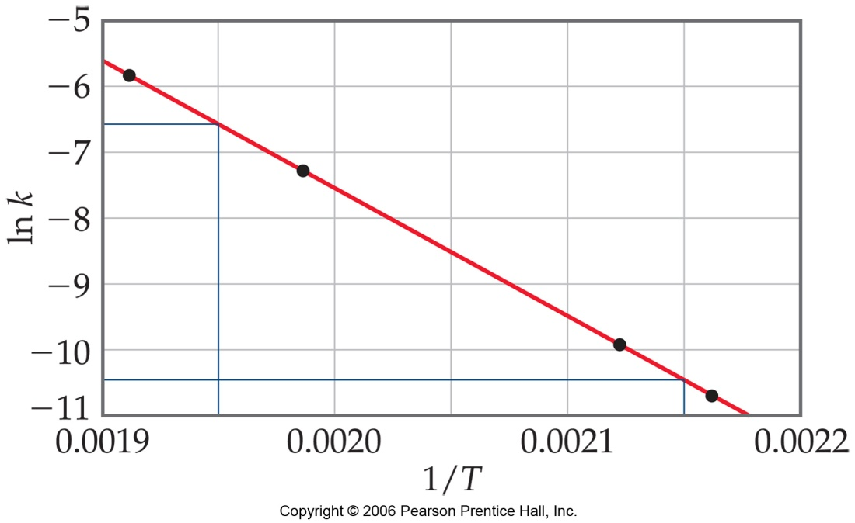
Arrhenius Equation
Taking the natural logarithm of both sides, the equation becomes
1
RT
y = mx + b
When k is determined experimentally at several temperatures, E_{a}can be calculated from the slope of a plot of ln k vs. 1/T.
15

Slide 16
Arrhenius Equation
Consider two points on the straight line, the Arrhenius Equation
Can be modified as follows
If you have two rate constants and two temperatures you can calculate Ea. Note the frequency factor Ln A cancels out
16

Slide 17
Arrhenius Equation for 2 Temperatures
When measurements are taken for two different temperatures the Arrhenius equation can be symplified as follows:
Write the above equation twice, once for each of the two
Temperatures and then subtract the lower temperature
conditions from the higher temperature. The equation then
becomes:
17.

Slide 18
Arrhenius Equation Sample Problem 1
The rate constant for the decomposition of hydrogen iodide was determined at two different temperatures
2HI → H₂ + I₂.
At 650 K, k₁ = 2.15 x 10⁻⁸ dm³ mol⁻¹s⁻¹
At 700 K, k₂ = 2.39 x 10⁻⁷ dm³ mol⁻¹s⁻¹
Find the activation energy for this reaction.
[
]
2.39 x 10⁻⁷ Ea
Ln ---------------- = - ------------------------ x
2.15 x 10⁻⁸ (8.314 J mol⁻¹ K⁻¹)
E_{a} = 180,000 J mol⁻¹ = 180 kJ mol⁻¹
1 1
------ -- ------
700K 650K
18.

Slide 19
End
19

Slide 20
Bibliography
http://lincoln.pps.k12.or.us/lscheffler/
http://www.chem.purdue.edu/gchelp/vsepr/structur2.html
http://www.chemistryexplained.com/Hy-Kr/Kinetics.html
Geoffrey Neuss. Chemistry course companion. Bell and Bain Ltd. Glascow, 2007.

