Slide 1
Kinetics
Order of reaction and Half Life
By Adriana Hartmann

Slide 2
Rate Laws
A rate law shows the relationship between the reaction rate and the concentrations of reactants.
For gas-phase reactants use P_{A} instead of [A].
k is a constant that has a specific value for each reaction.
The value of k is determined experimentally.
The Rate “Constant” is relative
k is unique for each reaction
k changes with T (section 14.5)
2

Slide 3
Rate Laws
Exponents tell the order of the reaction with respect to each reactant.
This reaction is
First-order in [NH₄⁺]
First-order in [NO₂⁻]
The overall reaction order can be found by adding the exponents on the reactants in the rate law.
This reaction is second-order overall.
3

Slide 4
Integrated Rate Laws
The integrated form of first order rate law:
Can be rearranged to give:
[A]₀ is the initial concentration of A (t=0).
[A]_{t} is the concentration of A at some time, t, during the course of the reaction.
4

Slide 5
Integrated Rate Laws
Manipulating this equation produces…
…which is in the form
y = mx + b
5

Slide 6
First-Order Processes
If a reaction is first-order, a plot of ln [A]_{t} vs. t will yield a straight line with a slope of -k.
Graphs can be used to determine reaction order.
6

Slide 7
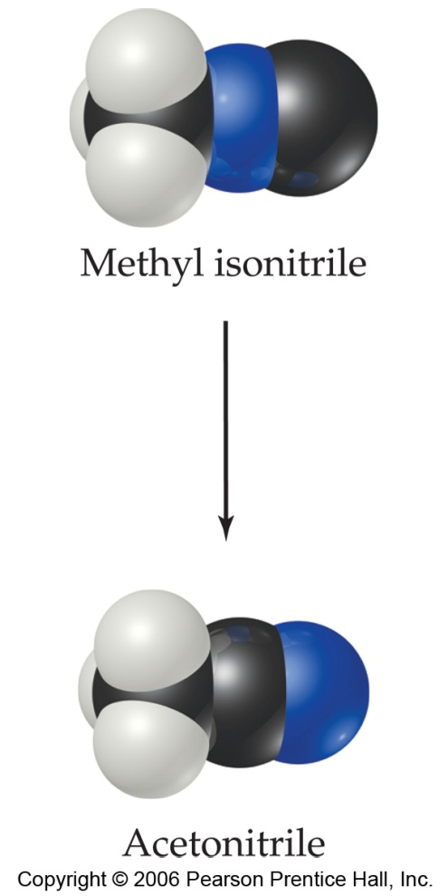
First-Order Processes
Consider the process in which methyl isonitrile is converted to acetonitrile.
CH₃₋N=C
CH₃₋C=N
7

Slide 8
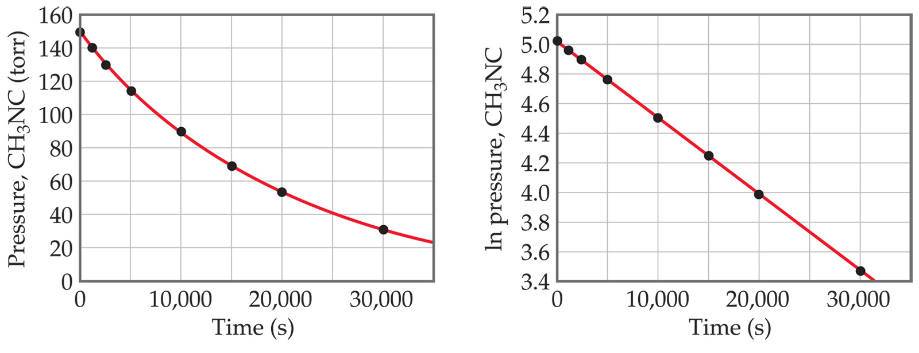
First-Order Processes
When ln P is plotted as a function of time, a straight line results.
The process is first-order.
k is the negative slope: 5.1 × 10⁻⁵ s⁻¹.
8

Slide 9
First Order Rate Calculations
Example 3: Radioactive decay is also a first order process. Strontium 90 is a radioactive isotope with a half-life of 28.8 years. If some strontium 90 were accidentally released, how long would it take for its concentration to fall to 1% of its original concentration?
9.

Slide 10
First Order Rate Calculations
Example 3: Radioactive decay is also a first order process. Strontium 90 is a radioactive isotope with a half-life of 28.8 years. If some strontium 90 were accidentally released, how long would it take for its concentration to fall to 1% of its original concentration?
Solution
k =0.693/t_{1/2} =0.693/28.8 yr =0.02406 yr⁻¹
Ln[1] – Ln(100) = - (0.02406 yr⁻¹)t = - 4.065
t = - 4.062 .
- 0.02406 yr⁻¹
t = 168.8 years
10.

Slide 11
Second-Order Processes
if a process is second-order in A, a plot of 1/[A] vs. t will yield a straight line with a slope of k.
Compare this to the
First order:
If a reaction is first-order, a plot of ln [A]_{t} vs. t will yield a straight line with a slope of -k
11

Slide 12
Determining reaction order
The decomposition of NO₂ at 300°C is described by the equation
NO₂(g)
NO (g) + 1/2 O₂(g)
Time (s) | [NO₂], M
0.0 | 0.01000
50.0 | 0.00787
100.0 | 0.00649
200.0 | 0.00481
300.0 | 0.00380
and yields these data:
12

Slide 13
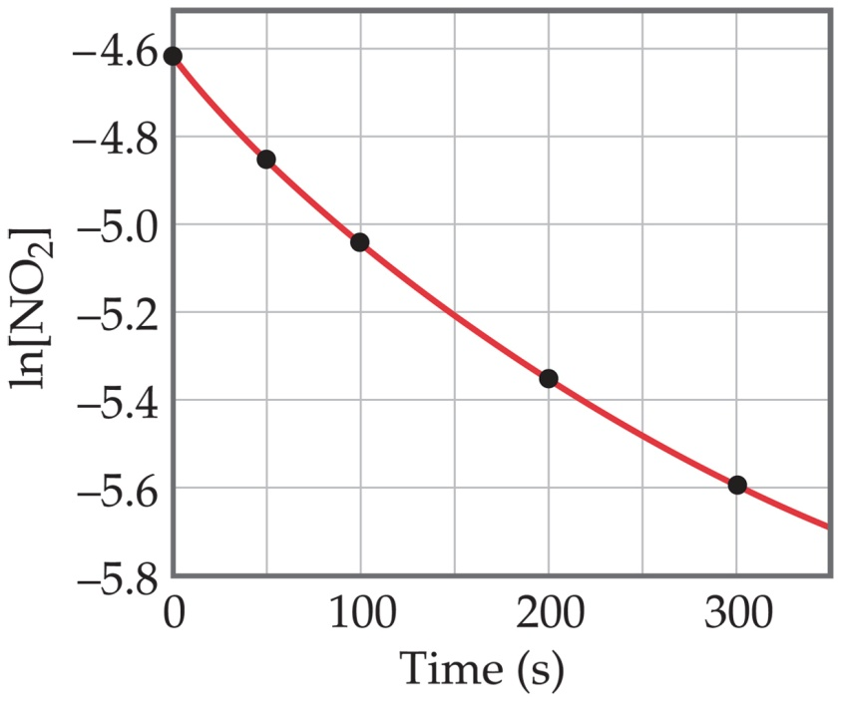
Determining reaction order
Graphing ln [NO₂] vs.t yields:
The plot is not a straight line, so the process is not first-order in [A].
Time (s) | [NO₂], M | ln [NO₂]
0.0 | 0.01000 | -4.610
50.0 | 0.00787 | -4.845
100.0 | 0.00649 | -5.038
200.0 | 0.00481 | -5.337
300.0 | 0.00380 | -5.573
Does not fit:
13

Slide 14
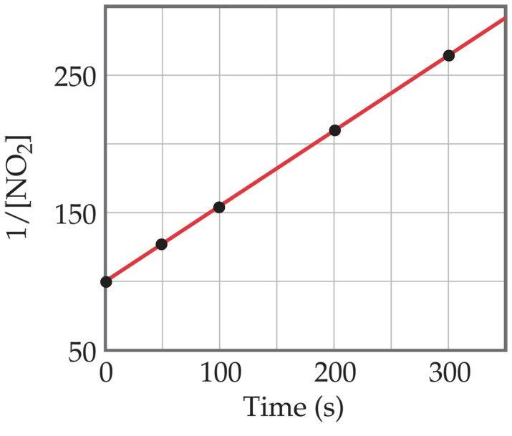
Second-Order Processes
A graph of 1/[NO₂] vs. t gives this plot.
This is a straight line. Therefore, the process is second-order in [NO₂].
Time (s) | [NO₂], M | 1/[NO₂]
0.0 | 0.01000 | 100
50.0 | 0.00787 | 127
100.0 | 0.00649 | 154
200.0 | 0.00481 | 208
300.0 | 0.00380 | 263
14

Slide 15
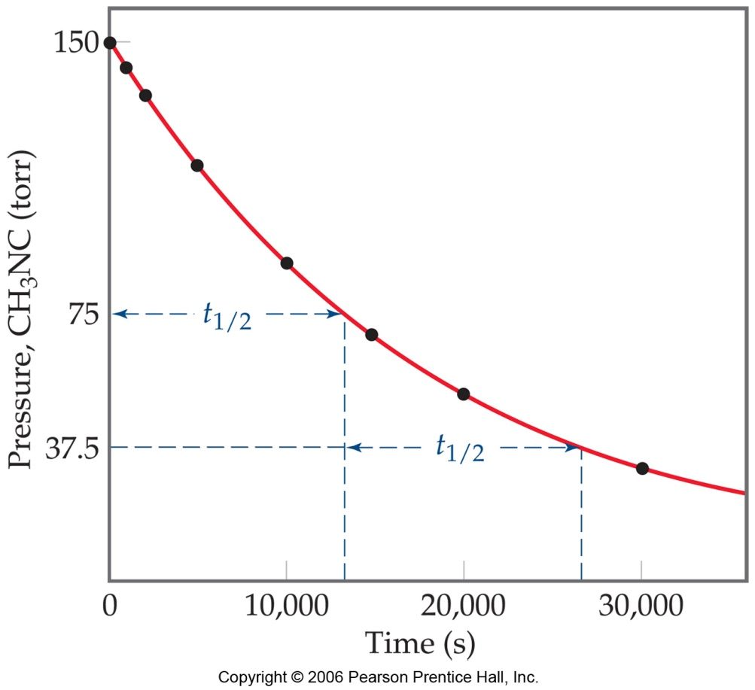
Half-Life
Half-life is defined as the time required for one-half of a reactant to react.
Because [A] at t_{1/2} is one-half of the original [A],
[A]_{t} = 0.5 [A]₀.
15

Slide 16
Half-Life – First Order
For a first-order process, set [A]_{t}=0.5 [A]₀ in integrated rate equation:
NOTE: For a first-order process, the half-life does not depend on [A]₀.
16

Slide 17
Half-Life- 2nd order
For a second-order process, set
[A]_{t}=0.5 [A]₀ in 2nd order equation.
17

Slide 18
Sample Problem 1: Second Order
Acetaldehyde, CH₃CHO, decomposes by second-order kinetics with a rate constant of 0.334 mol⁻¹dm³s⁻¹ at 500ºC. Calculate the amount of time it would take for 80 % of the acetaldehyde to decompose in a sample that has an initial concentration of 0.00750 M.
The final concentration will be 20% of the original 0.00750 M or = 0.00150
1 .
.00150
1 .
.00750
= 0.334 mol⁻¹dm³s⁻¹ t +
666.7 = 0.334 t + 133.33
0.334 t = 533.4
t = 1600 seconds
18.

Slide 19
Sample Problem 2: Second Order
Acetaldehyde, CH₃CHO, decomposes by second-order kinetics with a rate constant of 0.334 mol⁻¹dm³s⁻¹ at 500ºC. If the initial concentration of acetaldehyde is 0.00200 M. Find the concentration after 20 minutes (1200 seconds)
Solution
1 .
[A]_{t}
1 .
0.00200 mol dm⁻³
= 0.334 mol⁻¹dm³s⁻¹ (1200s) +
1 .
[A]_{t}
= 0.334 mol⁻¹dm³ s⁻¹ (1200s) + 500 mol⁻¹dm³
= 900.8 mol⁻¹dm³
1 _____.
900.8 mol⁻¹dm³
[A]_{t} =
= 0.00111 mol dm⁻³
19.

Slide 20
Outline: Kinetics
 | First order | Simple Second order | Second order overall
Rate Laws
Integrated Rate Laws |  |  | complicated
Half-life |  |  | complicated
Practice problems
20

Slide 21
End
21

Slide 22
Bibliography
http://www.shodor.org/unchem/advanced/kin/index.html
http://www.chemistryexplained.com/Hy-Kr/Kinetics.html
http://en.wikipedia.org/wiki/Reaction_rate
Geoffrey Neuss. Chemistry course companion. Bell and Bain Ltd. Glascow, 2007.

