Slide 1
Food Chemistry
Paula Aleixo Penna Pereira

Slide 2
Food and Nutrients
Foods are substances intended for human consumption.
Nutrients are substances obtained from food that keep the body healthy and functioning. They provide energy, regulate growth, and replenish chemicals for the maintenance and repair of the body’s tissues.
They are divided into six main groups: proteins, carbohydrates, lipids, vitamins, minerals, and water.

Slide 3
Carbohydrates
Simple carbohydrates are known as monosaccharides with an empirical formula of CH2O.
Contain a carbonyl group (C=O) and at least two OH groups.
Have between three and six carbon atoms.
Monosaccharides can undergo condensation reactions to form disaccharides and eventually polysaccharides.
* Monosaccharides with the general formula C ₅H ₁₂O ₆ are known as pentoses (e.g. ribose) and monosaccharides with the general formula C ₆H ₁₂O₆ are known as hexoses (e.g. glucose).

Slide 4
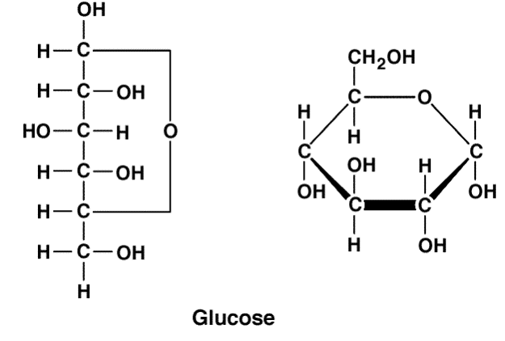
Glucose
Can exist as a straight chain isomer or as a ring compound:

Slide 5
Lipids (Fats and Oils)
Fats and oils are triesters (triglycerides) formed from the condensation reaction of propane 1,2,3-triol (glycerol) with long chain carboxylic acids (fatty acids).
Fats are solid triglycerides (e.g. butter).
Oils are liquid at room temperature(e.g. olive oil).
Chemical difference: fats contain saturated carboxylic acid group (i.e. they do not contain C=C double bonds). Oils are unsaturated, containing at least one. Most oils contain several C=C double bonds and are known as polyunsaturated.

Slide 6
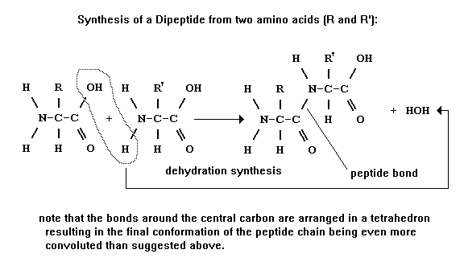
Proteins
Large macromolecules made up of chains of 2-amino acids.
The amino acids bond to each other through condensation reactions resulting in the formation of a polypeptide in which the amino acid residues are joined to each other by an amide link (peptide bond).
*Look at the study guide (page 145) for the structural formula.

Slide 7
Properties of fats and oils
The melting points of fatty acids increase with their relative molecular mass.
The melting points are also affected by the degree of unsaturation. Unsaturated fatty acids have lower melting points and tend to be less crystalline.
The tetrahedral arrangement in the carbon ´backbone´ of saturated acids makes them pack closer together and the van der Waals´ forces holding the molecules closer together are stronger as the surface area between them is greater.
The way in which unsaturated fatty acids can pack also depends on the geometrical isomerism of the double bonds.
Trans-fatty acids pack more closely than cis-fatty—where both hydrogen atoms are on the same side of the double bonds acids. Therefore, trans-fatty acids have a higher melting point.
Unsaturated fats are less chemically stable because the carbon double bonds can react with oxygen (auto-oxidation), light (photo-oxidation), hydrogen (hydrogenation), and water (hydrolysis) under the presence of heat and enzymes.

Slide 8
Examples of fats and oils
Mainly saturated fats (solids at room temperature) | Mainly mono-unsaturated oils (liquids at room temperature) | Mainly poly-unsaturated oils (liquids at room temperature)
Palm, coconut, butter | Peanut, canola, olive | Safflower, sunflower, linoleic

Slide 9
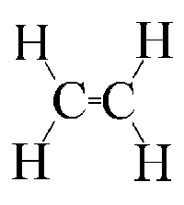
Hydrogenation of Unsaturated Fats
The addition of hydrogen in the presence of heat and a finely divided nickel (or zinc or copper) catalyst increases the amount of saturation.
Advantages:
Increases the melting point and hardness and is used in the manufacture of margarine. It also i
Increases the chemical stability.
Disadvantages:
Oils naturally only contain cis-fatty acids but under partial hydrogenation trans-fatty acids can form.
Ni
+ H₂ →
140-225°C

Slide 10
Trans-fatty acids
Harder to metabolize and excrete.
Lower quality energy source.
Behave like saturated fats and increase levels of LDL (low density lipoprotein) cholesterol and leading to an increased risk of heart disease.

Slide 11
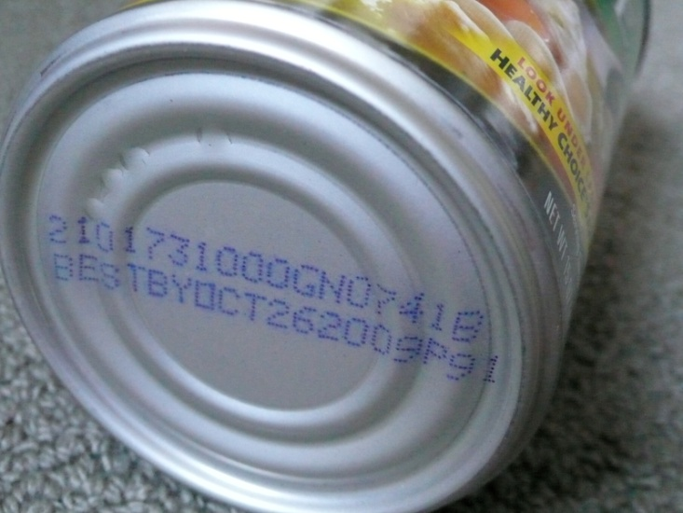
Shelf Life
Shelf life: the amount of time a food maintains its top quality. However, if a food is past its shelf life, it may still be safe to consume.
Factors affecting shelf life:
Water content: a change of the water content can cause loss of nutrients, browning, and rancidity. Dry foods become more vulnerable to microbial spoilage if they absorb water.
pH: changes in pH can cause changes in flavor, color, browning, and loss of nutrients.
Light: can lead to rancidity, loss of vitamins, and fading of natural color.
Temperature: a high temperature increases the rate of the other forms of spoilage
Exposure to air: can increase the rate of oxidation causing browning, loss of nutrients, and changes in flavor and color.
Expiration date determines end of shelf life.

Slide 12
Rancidity
Lipids become rancid when we think they have “gone off”.
Caused either by the hydrolysis of the triesters or by the oxidation of the fatty acids.

Slide 13
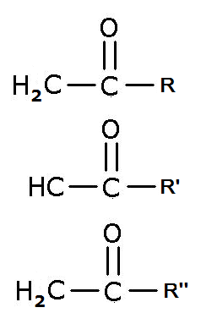
Hydrolytic rancidity:
Hydrolytic rancidity:
Caused by the breaking down of a lipid into its component fatty acids.
Reverse of esterification.
Occurs more rapidly with moisture, heat, and enzymes such as lipase.
Example of this process: deep frying.
Fatty acids responsible for rancidity:
Butanoid acid in milk in milk and butter
Oleic acid in chocolate (gives it a oily or fatty flavor)
Lauric acid in palm and coconut oil, in cocoa butter substitutes, (giving them a soapy flavor).
3H₂O →
RCOOH + R´COOH + R´´COOH +
Glycerol

Slide 14
Oxidative Rancidity
Due to the oxidation of the fatty acid chains, usually by the addition of oxygen across the C=C double bond in unsaturated fatty acids.
Oily fishes contain a high amount of unsaturated fatty acids and are prone to oxidative rancidity.
Proceeds by a free radical mechanism catalyzed by light in the presence of enzymes or metal ions.
This photo-oxidation leads to the formation of hydroperoxides.
*Hydroperoxides have the formula ROOH and break down to form free radicals due to the weak O₆ single bond they contain.

Slide 15
Prolonging shelf life and minimizing the rate of rancidity
Moulds and bacteria thrive in moderate temperatures, high humidity, and low salt concentration.
Traditional methods of preserving food include: fermentation (with alcohol), preserving with sugar, pickling with vinegar (ethanoic acid), salting (with sodium chloride), drying, and smoking.
Processing | Packaging | Use of additives
Refrigeration and freezing—storing dairy products at low temperature slows lipase hydrolysis Reducing light levels by using colored glass or keeping in a dark place. Radiation. Using gamma radiation or X-rays to destroy microorganisms. | Using an inert gas to minimize contact with oxygen. Using hermetic sealing or low-gas permeability packaging film. Keeping jars full to minimize the amount of air in the headspace above oil. Sealing in tin cans. | To delay onset of enzymatic browning: sodium sulfite, sodium hydrogensulfite, and citric acid. To cure meat, fix color and inhibit micro-organisms: sodium and potassium nitrite and nitrate. To delay mould and bacterial growth in breads and cheeses: sorbic and propanoic acids and calcium and sodium propanoates. To delay mould and bacterial growth in pickled meats and fish as well as adding flavor: ethanoic acid and benzoic acid. Antimicrobial agents in fruit juices, carbonated drinks, pickles, and sauerkraut: sodium benzoate and benzoic acid.

Slide 16
Naturally Occuring Antioxidants
Antioxidants delay the onset or slow down the rate at which oxidation occur and hence extend the shelf life of foods.
Naturally occurring antioxidants include:
Vitamin C (ascorbic acid): found in citrus fruits, green peppers, and potatoes.
Vitamin E (tocopherols): found in nuts, seeds, and whole grains.
β-carotene: found in carrots, tomatoes, and broccoli.
Selenium: found in fish, red meat, and garlic.

Slide 17
Synthetic Antioxidants
Common structures found in synthetic antioxidants
Phenolic group (-OH joined directly to a benzene ring).
Tertiary butyl group (carbon atom bonded directly to three methyl groups).
Both of these groups are free radical scavengers, meaning they react with and remove free radicals involved in the oxidation of food and thus prolong the shelf life.

Slide 18
Antioxidants in Food
PROS
CONS
Naturally occurring vitamins C, E, and carotenoids reduce the risk of cancer and heart disease by inhibiting the formation of free radicals.
Vitamin C is vital for the production of hormones and collagen.
β- carotene can act as a precursor for vitamin A synthesis and can also give margarine its yellow color.
Synthetic antioxidants are thought to be less safe as they do not occur naturally.
Natural antioxidants are more expensive and less effective than synthetic antioxidants and can also add unwanted color and leave an aftertaste in food.
Policies regarding the safe use and labeling of food additives can be difficult to implement and monitor, especially in developing countries and across borders.

Slide 19
Antioxidants in Traditional Food
Vitamin C and carotenoids can be found in many fruits and vegetables.
Flavonoids:
natural antioxidants.
Found in red wine, dark chocolate, and oregano.
Have been linked to lowering levels of LDL (low density lipoprotein) cholesterol and blood sugar levels which reduce high blood pressure and prevent the development of cancerous cells.

Slide 20
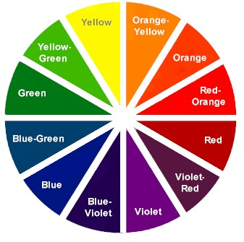
Food Color
A food has color because substances are able to absorb and reflect light from the visible region of the electromagnetic spectrum. The light that is reflected is referred to as the complementary color and it is the one that is the one we perceive.
The substances that give food its color can be natural or synthetic.
Natural colorants found in plants and animals are called pigments.
Synthetic food-grade water-soluble substances that are added to food to give color are called dyes.
Complementary colors are opposite to each other.

Slide 21
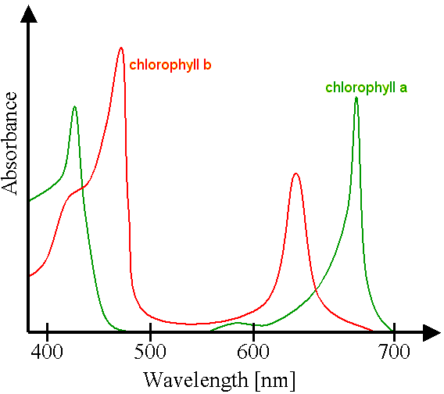
Analyzing Color From Spectra
Visible light wavelength: between 400nm to 700nm.
ROYGBIV→ decreasing wavelength and increasing energy
Both chlorophylls will be green because the light being transmitted is in the 500-550 nm region of the spectrum. However, they will be slightly different because of the slight differences in the graph.

Slide 22
Pigments
Pigments that occur naturally: anthocyanins, carotenoids, chlorophyll, and haem.
Anthocyanins | Carotenoids | Chlorophyll | Haem
Most widely occurring pigment in plants. Responsible for the pink, red, purple, and blue colors in fruits and vegetables, including cranberries, blueberries, strawberries, and raspberries. | Most widespread pigments in nature (mostly produced by algae). Act as a precursor for vitamin A synthesis. Colors range from yellow to red/orange. It is found in bananas, carrots, tomatoes, watermelon, peppers, and saffron. Red astaxanthin (complexed to a protein) is responsible for the blue or green color of live lobsters and crabs and the pink color of salmon and flamingos. | Pigments found in green plants that are required for photosynthesis. | Myoglobin is responsible for the purple-red color of fresh meat.

Slide 23
Synthetic Colorants (Dyes)
Food additives are given numbers so they are identified. In some parts of the world these are known as E numbers and elsewhere an International Numbering System (INS) is used.
Countries have different regulations and with an international food market a legislation must be employed.
Many dyes used in the past have been shown to be potentially carcinogenic and have been withdrawn.

Slide 24
Factors Affecting the Color Stability of Pigments
Changes in the structure of a molecule will affect the color because the wavelength of visible light it reflects will change.
These include:
Oxidation
Temperature changes
pH changes
Presence of metal ions

Slide 25
Anthocyanins
Exist in different forms
In aqueous solutions these different forms are in equilibrium with each other.
Changing the pH and the temperature affects the position of equilibrium and therefore the color.
Most highly colored at low pH and at low temperatures.
When exposed to heat the equilibrium moves to the right and the compounds are less thermodynamically stable—which causes a loss of color and browning.
Quinoid (A)↔Flavylium (AH+)↔Carbinol↔Chalcone
(Blue) (Red) (Colorless)
Form complexes with metal ions such as aluminum ions, Al⁺³, and iron (III) ions, Fe⁺³. these ions are present in tin cans, which is why food can become discolored if they are inside.

Slide 26
Carotenoids
Alternate carbon to carbon single and double bonds which when bonded together make it colored.
Example: β-carotene—an antioxidant and pigment as well.
Because of the unsaturation carotenoids are susceptible to oxidation. The process of oxidation can be catalyzed by light, metals and hydroperoxides. This changes the type of bonding and results in the bleaching of color, loss of vitamin A activity and is the cause of bad smells.
Stable up to 50°C and in a pH range of 2-7 and are therefore not degraded by most forms of food processing. When heated the naturally occurring trans-isomer rearranges to the cis-isomer.

Slide 27
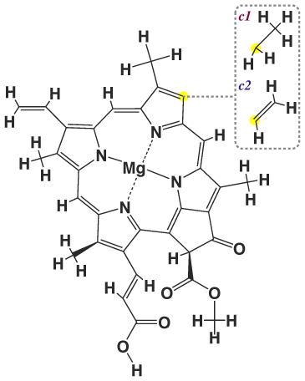
Chlorophyll
Different forms of chlorophyll contain different groups attached in the R- position.
Contains a group with four nitrogen atoms which is called a porphin. The porphin ring forms a stable complex with a magnesium ion.
The stability depends on the pH. In a basic solution with a pH of 9 it is thermodynamically stable but in acidic solution with a pH of 3 it is not. When heated, the cell membrane of the plant deteriorates releasing acids, resulting in the displacement of the magnesium ion by two hydrogen ions. This makes an olive-brown pheophytin complex. This breakdown of the cell with heat makes chlorophyll more susceptible to decomposition by light.

Slide 28
Haem
Contains a porphin ring contains a porphin ring complexed to an iron ring.
During oxidation, oxygen binds to purple-red myoglobin (Mb), and red oxymyoglobin (MbO₂) forms.
In both the iron in the haem group is in the form of Fe ²⁺.
Through auto-oxidation of Mb and MbO₂ the iron changes to Fe ³⁺. –when it is known as metmyoglobin (MMb) and has an undesirable brown-red color.
Interconvention between these forms occur readily:
MbO₂ ↔ Mb ↔ MMb
(red) (purple-red) (brown)
To minimize rate of formation of MMb from auto-oxidation, meat can be stored free of oxygen with the methods stated previously.

Slide 29
Non-Enzymatic Browning of Food
Caramelization
Foods that are high in carbohydrate content and lacking nitrogen containing compounds can be caramelized; e.g. sucrose and glucose.
Can be achieved by heating
Sucrose and glucose can form acids, sweets, and bitter derivatives, volatile molecule with a caramel aroma and brown colored polymers.
Temperature and pH affect the rate of caramelization. Catalysis occurs with pH values below 3 and above 9. Caramelization will happen with a temperature above 120°C as foods with high sugar content are baked or roasted.
Example: browning on the top of baked egg dishes.

Slide 30
Maillard Reaction
For foods containing nitrogen
Condensation reaction between the carbonyl group on the reducing sugar and the amine group.
Foods that contain (which contain two amine groups) results in the most browning color and cysteine the least.
Example of food containing lysine: milk.
Example of Maillard reaction: making milk chocolate and heating sugar and cream to make fudge, toffees, and caramels.

Slide 31
The Texture of Food
Foods seem to be homogeneous because the sizes of the phases can be very small.
Dispersed system: a kinetically stable mixture of on phase within another largely immiscible phase.
Types of dispersed system:
Suspension: solid dispersed in a liquid. Example: molten chocolate
Emulsion: liquid dispersed in a liquid. Example: cream
Foam: gas dispersed in a liquid. Example: beer

Slide 32
Emulsifiers
Types of food emulsion:
Water-in-oil: dispersion of water droplets in a continuous oil phase. Example: butter.
Oil-in-water is more common in manufactured foods. Example: milk and salad dressing.
Emulsifying agents (emulsifiers): substances that aid the dispersal of these droplets and stabilize them to prevent them coalescing to form larger globules.
They act as an interphace between the gas, liquid, or solid phases in the dispersed systems.
Used in making foam.
Good emulsifiers tend to be soluble in both fats (oils) and water.
Example: lecithin.
To physically make na emulsion mechanical energy is also required. This aids the dispersion which explains the need for beating, mixing, and whisking in cooking.
Stabilizers can also be added to prevent the emulsions and foams from separating out into the separate phases.

Slide 33
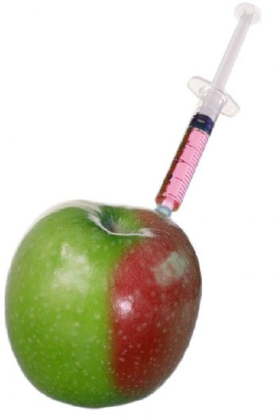
Genetically Modified Food
A food derived from a genetically modified organism.
Pros
Cons
Plants can be made more resistant to disease, herbicides, and insect attack.
Anti-cancer substances and increased amounts of vitamins could be incorporated and exposure to less healthy fats reduced.
Can lead to soil, water, and energy conservation and impove natural waste management.
Genetically engineered genes may escape and contaminate normal crops with unknown effects.
They may cause disease as the anti-biotic resistant genes could be passed to harmful microorganisms.
Links to an increase in allergic reactions (mostly in the food processing).
*There are more pros and cons in the study guide.

