Slide 1
Equilibrium
Shir Levanon & Paula Aleixo Pereira

Slide 2
Le Châtelier’s Principle
Any change to a chemical reaction at dynamic equilibrium causes the reaction to proceed in the direction that reduces the effect of the change
There are 3 ways to change the position of equilibrium:
Changing the concentration of one of the components of the reaction
Changing the pressure on the system
Changing the temperature in which the reaction runs

Slide 3
Equilibrium constant (Kc)
aA + bB ↔ cC + dD
Kc= [C]^{c}[D]^{d}/[A]ª[B]^{b}
If changes are made to the concentration, pressure, or temperature of the reaction that makes the position of equilibrium move to the reactants’ side, Kc will decrease. If the changes make it shift to the products side, Kc will increase.

Slide 4
Changing the Concentration
If the concentration of a substance is changed the reaction will shift to the side that compensates it. If the concentration of a substance is increased, the reaction will shift to the side without such substance to use it up. Meanwhile, if the concentration of this substance is decreased, the reaction will shift to its side to produce more of it.
For example:
H₂(g)+I₂↔2HI
The Kc of this reaction is: [HI]²/[H₂][I₂]
If the concentration of hydrogen gas is increased, the reaction will shift to the right to use up the additional hydrogen. This will result in a higher Kc because more HI will be produced.

Slide 5
Changing the Pressure
If the pressure on a system of equilibrium is changed the reaction will shift to the side that compensates it. If the pressure is increased, the reaction will shift to the shift to the side with less moles.
For example:
2SO₂+O₂↔2SO₃
The Kc of this reaction is: [SO₃]²/[SO₂]²[O₂]
If the pressure is increased, the reaction will shift to the right because it has 2 moles while the
left has 3—resulting in a higher Kc.

Slide 6
Changing the Temperature
If the temperature the reaction runs in is changed the reaction will shift to the side that compensates it. If the temperature is increased, the reaction will absorb the additional heat by shifting to the endothermic side of the reaction. Meanwhile, if the temperature is decreased, the reaction will release the heat removed by shifting to the exothermic side of the reaction.
For example:
3H₂+N₂↔2NH₃ ΔH=-92kJmol⁻¹
The Kc of this reaction is: [NH₃]²/[H₂] ³[N₂]
If the temperature of the system is increased, the reaction will shift to the left because the reverse reaction is endothermic—the opposite of the forward one. This will result in a lower value of Kc because the amount of reactants will increase.

Slide 7
Application of the concepts of kinetics and equilibrium to industrial processes
Haber Process
3H₂+N₂↔2NH₃ ΔH=-92kJmol⁻¹
Catalyst used: Iron metal (Fe)
Temperature: 450°C
Pressure: 200-1000atm
To increase the yield of ammonia a low temperature and high pressure would be needed. However, a low temperature would make the reaction too slow and a the cost of maintaining a higher pressure would be more than the value of the extra ammonia produced.
Uses of the process: ammonia is used in manufacture of fertilizers and nitric acid.
Contact Process
2SO₂+O₂↔2SO₃ ΔH=-192kJmol⁻¹
Catalyst used: Vanadium (V) Oxide (V₂O₅)
Temperature: 450°C
Pressure: 1-2atm
To increase the yield of ammonia a low temperature and high pressure would be needed. However, a low temperature would make the reaction too slow and a the cost of maintaining a higher pressure would be more than the value of the extra sulfuric acid produced.
Uses of the process: sulfuric acid is used in manufacture of fertilizers, paint, and detergents.
*The catalyst does not increase the yield because it provides a pathway with a lower activation energy for the forward and reverse reactions—making the position of equilibrium be reached faster but making the concentrations of the reactants and products the same.

Slide 8
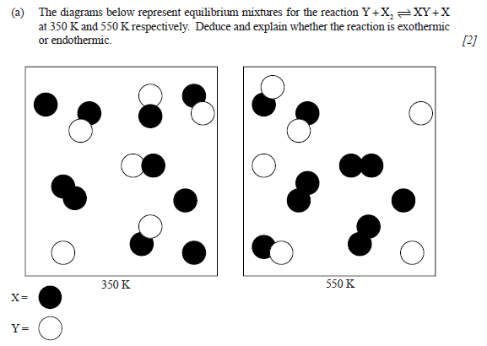
Specimen
This reaction is exothermic because the diagrams show that when the temperature is increased the amount of products decrease, meaning the reaction shifted to the left to absorb the heat put in.

