Slide 1
Energy and Chemical Reactions
Salvatore Affinito Class of 2011 HL Chemistry 2009-2001
May 2009
1

Slide 2
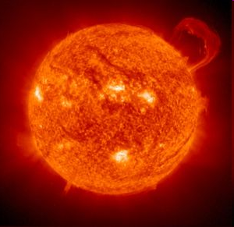
Heat and Temperature
Heat is energy that is transferred from one object to another due to a difference in temperature
Temperature is a measure of the average kinetic energy of a body
Heat is always transferred from objects at a higher temperature to those at a lower temperature.
2

Slide 3
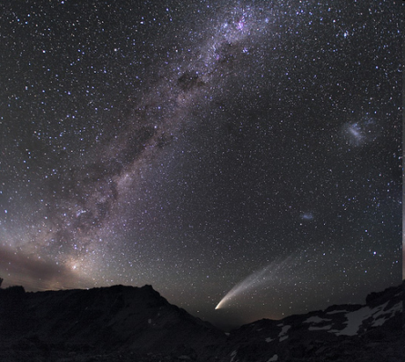
Factors Affecting Heat Quantities
The amount of heat contained by an object depends primarily on three factors:
The mass of material
The temperature
The kind of material and its ability to absorb or retain heat.
3

Slide 4
Heat Quantities
The heat required to raise the temperature of 1.00 g of water 1 ºC is known as a calorie
The SI unit for heat is the joule. It is based on the mechanical energy requirements.
1.00 calorie = 4.184 Joules
4

Slide 5
Calorimetry
Calorimetry: the measurement of heat changes that occur in chemical processes or reactions.
The heat change that occurs when a substance absorbs or releases energy is a function of three quantities:
The mass
The temperature change
The heat capacity of the material
5

Slide 6
Specific Heat
The ability of a substance to absorb or retain heat varies widely.
The heat capacity depends on the nature of the material.
Specific heat: heat required to raise the temperature of 1 gram of a substance 1 ºC
6

Slide 7
Specific Heat values for Some Common Substances
Substance | CJ g⁻¹ K⁻¹ | C J mol⁻¹K⁻¹
Water (liquid) | 4.184 | 75.327
Water (steam) | 2.080 | 37.47
Water (ice) | 2.050 | 38.09
Copper | 0.385 | 24.47
Aluminum | 0.897 | 24.2
Ethanol | 2.44 | 112
Lead | 0.127 | 26.4
7

Slide 8
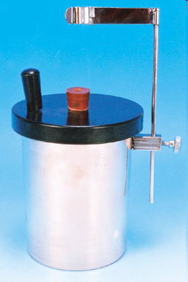
Heat Changes
The heat equation may be stated as
ΔQ = m C ΔT
where:
ΔQ = Change in heat
m = mass in grams
C = specific heat in J g⁻¹ ºC⁻¹
ΔT = Temperature change
8

Slide 9
Temperature Changes
Measuring the temperature change in a calorimetry experiment can be difficult since the system is losing heat to the surroundings even as it is generating heat.
By plotting a graph of time vs. temperature it is possible to extrapolate back to what the maximum temperature would have been had the system not been losing heat to the surroundings.
A time v temperature graph
9

Slide 10
Heat Transfer Problem 1
Calculate the heat that would be required for an aluminum cooking pan whose mass is 400 grams, to raise from 20ºC to 200ºC. The specific heat of aluminum is 0.902 J g⁻¹ ºC⁻¹.
Solution
ΔQ = mCΔT
= (400 g) (0.902 J g⁻¹ ºC⁻¹)(200ºC – 20ºC)
= 64,944 J
10

Slide 11
Heat Transfer Problem 2
What is the final temperature when 50 grams of water at 20ºC is added to 80 grams water at 60ºC? Assume that the loss of heat to the surroundings is negligible. The specific heat of water is 4.184 J g-1 ºC⁻¹
Solution: ΔQ _{(Cold)} = ΔQ (_{hot}) mCΔT= mCΔT
Let T = final temperature
(50 g) (4.184 J g⁻¹ ºC⁻¹)(T- 20ºC)
= (80 g) (4.184 J g⁻¹ ºC⁻¹)(60ºC- T)
(50 g)(T- 20ºC) = (80 g)(60ºC- T)
50T -1000 = 4800 – 80T
130T =5800
T = 44.6 ºC
11

Slide 12
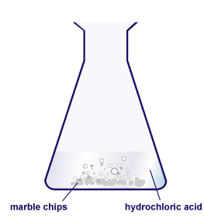
Chemical Reactions
In a chemical reaction
Chemical bonds are broken
Atoms are rearranged
New chemical bonds are formed
These processes always involve energy changes
12

Slide 13
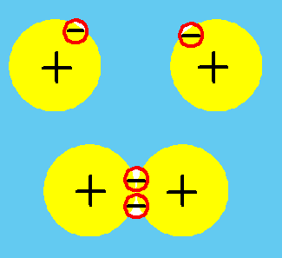
Energy Changes
Breaking chemical bonds requires energy
Forming new chemical bonds releases energy
13

Slide 14
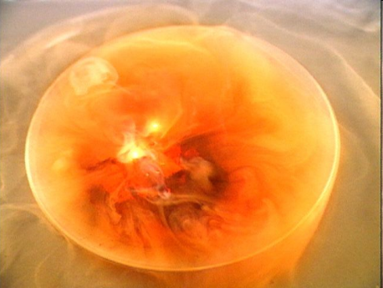
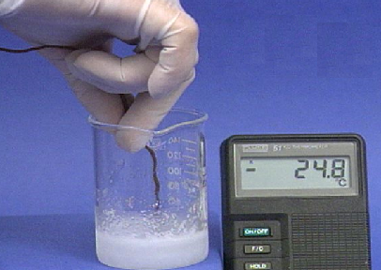
Exothermic and Endothermic Processes
Exothermic processes release energy
C₃H₈ (g) + 5 O₂ (g) → 3 CO₂ (g) + 4H₂O (g)
+ 2043 kJ
Endothermic processes absorb energy
C(s) + H₂O (g) +113 kJ → CO(g) + H₂ (g)
14

Slide 15
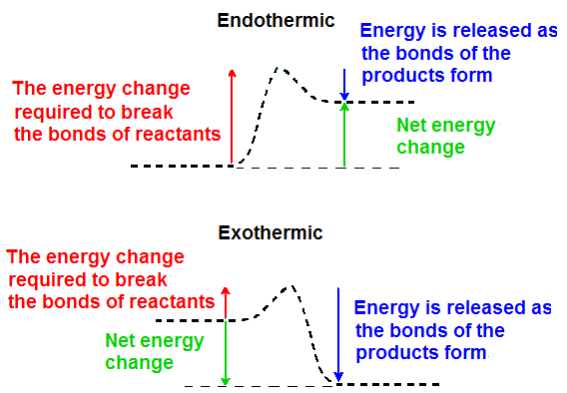
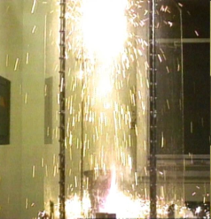
Energy Changes in endothermic and exothermic processes
In an endothermic reaction there is more energy required to break bonds than is released when bonds are formed.
The opposite is true in an exothermic reaction.
15

Slide 16
Enthalpy Calculations
16

Slide 17
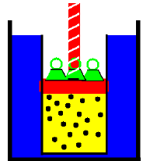
Enthalpy
Enthalpy is the heat absorbed or released during a chemical reaction where the only work done is the expansion of a gas at constant pressure
17

Slide 18
Enthalpy
Not all energy changes that occur as a result of chemical reactions are expressed as heat
Energy = Heat + Work
Work is a force applied over a distance.
Most energy changes resulting from chemical reactions are expressed in a special term known as enthalpy
18

Slide 19
Enthalpy
It is nearly impossible to set up a chemical reaction where there is no work performed.
The conditions for a chemical reaction are often set up so that work in minimized.
Enthalpy and heat are nearly equal under these conditions.
19

Slide 20
Enthalpy Changes
The change in enthalpy is designated by the symbol ΔH.
If ΔH < 0 the process is exothermic.
If ΔH > 0 the process is endothermic.
Sometimes the symbol for enthalpy (ΔH) is used for heat (ΔQ)
In many cases where work is minimal heat is a close approximation for enthalpy.
One must always remember that while they are closely related, heat and enthalpy are NOT identical
20

Slide 21
Energy and Enthalpy Changes
It is impractical to measure absolute amounts of energy or enthalpy.
Hence we measure changes in enthalpy rather than total enthalpy
Enthalpy is always measured relative to previous conditions.
Enthalpy is measured relative to the system.
21

Slide 22
Measuring Enthalpy
The amount of heat absorbed or released during a chemical reaction depends on the conditions under which the reaction is carried out including:
the temperature
the pressure
the physical state of the reactants and products
22

Slide 23
Standard Conditions
For most thermodynamic measurements standard conditions are established as
25 ºC or 298 K
1.0 atmosphere of pressure
Note this is a change from the gas laws where the standard temperature was 0ºC
23

Slide 24
Standard State
The pure form of a substance at standard conditions (25ºC and 1 atmosphere) is said to be in the standard state.
The most stable form of an element at standard conditions represents the standard state for that element.
24

Slide 25
Bond Enthalpies
25

Slide 26
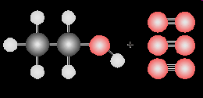
Bond Enthalpies
One approach to determining an enthalpy change for a chemical reaction is to compute the difference in bond enthalpies between reactants and products
The energy to required to break a covalent bond in the gaseous phase is called a bond enthalpy.
Bond enthalpy tables give the average energy to break a chemical bond. Actually there are slight variations depending on the environment in which the chemical bond is located
26

Slide 27
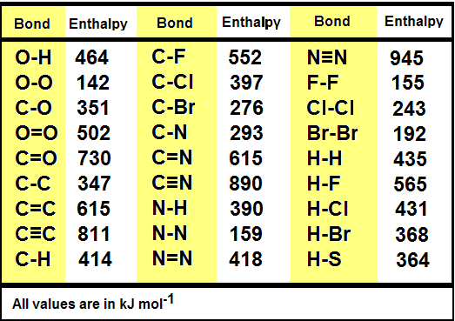
Bond Enthalpy Table
The average bond enthalpies for several types of chemical bonds are shown in the table below:
27

Slide 28
Bond Enthalpies
Bond enthalpies can be used to calculate the enthalpy change for a chemical reaction.
Energy is required to break chemical bonds. Therefore when a chemical bond is broken its enthalpy change carries a positive sign.
Energy is released when chemical bonds form. When a chemical bond is formed its enthalpy change is expressed as a negative value
By combining the enthalpy required and the enthalpy released for the breaking and forming chemical bonds, one can calculate the enthalpy change for a chemical reaction
28

Slide 29
Bond Enthalpy Calculations
Example 1: Calculate the enthalpy change for the reaction N₂ + 3 H₂ → 2 NH₃
Bonds broken
N⁼N: = 945
H-H: 3(435) = 1305
Total = 2250 kJ
Bonds formed
2x3 = 6 N-H: 6 (390) = - 2340 kJ
Net enthalpy change
= + 2250 - 2340 = - 90 kJ
29

Slide 30
Hess Law and Enthalpy Calculations
30

Slide 31
Standard Enthalpy Changes
The enthalpy change that occurs when the reactants are converted to products, both being in their standard states is known as the standard enthalpy change.
It is designated as ΔHº.
ΔHº reaction = Σ ΔHº products - Σ ΔHº reactants
31

Slide 32
Calculating Enthalpy from tables
The enthalpy of formation for compound is equal to the enthalpy change that occurs when a compound is formed from its elements
The symbol for the bond enthalpy of formation is ΔH_{f}
Enthalpies of formation have been measured and tabulated for a large number of compounds
32

Slide 33
Enthalpies of Formation
Some enthalpies of formation for common compounds
BaCO₃ | -1219 | H₂O (g) | -242 | HCl (g) | -93
Ba(OH)₂ | -998 | H₂O (l) | -286 | HCl (aq) | -167
BaO | -554 | H₂O₂ | -188 | NH₃ (g) | -46
CaCO₃ | -1207 | C₃H₈ | -104 | NO | +90
CaO | -636 | C₄H₁₀ | -126 | NO₂ | +33.8
Ca(OH)₂ | -987 | CO | -110 | SO₂ | -297
CaCl₂ | -796 | CO₂ | -394 | Al₂O₃(s) | -1670
See your text: Brown, LeMay and Bursten, Chemistry the Central Science,
7th edition pages 984-987 for addition values
33

Slide 34
Calculating Enthalpy from tables
Enthalpies of formation represent the enthalpy changes when compound forms from its elements
The enthalpy of formation for a chemical reaction can be expressed as the difference between the enthalpy state of the products and that of the reactants
ΔHreaction = Σ ΔHº_{products} –ΣΔHº_{reactants}
34

Slide 35
Sample Problem 1
Calcium carbonate reacts with hydrochloric acid according to the following equation:
CaCO₃ (s) + 2HCl (aq) → CaCl₂ (aq) + H₂O (l) + CO₂ (g)
Calculate the enthalpy change for this reaction
ΔHº_{reaction} = Σ ΔHº_{products} –ΣΔHº_{reactants}
Solution
ΔHº_{products} =(-796)+(-286)+(-394)
= -1476 kJ
ΔHº_{reactants} =(-1207)+(2)(-167)
= -1541 kJ
ΔHº_{reaction} = -1476-(-1541) = +75 kJ
ΔHºCaCO₃ | -1207
ΔHº HCl (aq) | -167
ΔHºCaCl₂ | -796
ΔHº H₂O (l) | -286
ΔHº CO₂ (g) | -394
35

Slide 36
Sample Problem 2
Calculate the enthalpy change for the burning of 11 grams of propane
C₃H₈ (g) + 5 O₂ (g) → 3 CO₂ (g) + 4 H₂O (g)
ΔHº_{reaction} = Σ ΔHº_{products} –ΣΔHº_{reactants}
Solution
ΔHº_{products} =(3)(-394)+(4)(-242)
= -2150 kJ
ΔHº_{reactants} =(-104)+(5)(0)
= -104 kJ
ΔHº_{reaction} = -2150-(-104) = -2046 kJmol⁻¹
ΔHº C₃H₈ | -104
ΔHº O₂ (g) | 0
ΔHº H₂O (g) | -242
ΔHº CO₂ (g) | -394
Now 11 grams = 0.25 mole of propane (11 g/44 g mol⁻¹)
(0.25 mol )(-2046 kJ mol⁻¹) = - 511.5 kJ
36

Slide 37
Some things to Remember
The enthalpy of formation table is stated in kJ mol⁻¹.
To find the sum of enthalpies of formation for reactants or products, multiply the number of moles of each substance by the enthalpy of formation for that substance.
Then find the difference: Products-Reactants
37

Slide 38
Hess’ Law – Indirect Enthalpy Calculations by Rearranging Reactions
Hess’ Law provides a way to calculate enthalpy changes even when the reaction cannot be performed directly.
If a series of reactions are added together, the enthalpy change for the net reaction will be the sum of the enthalpy change for the individual steps
38

Slide 39
Techniques
Equations may be multiplied, divided, or reversed and then added together to form a new equation
If an equation is multiplied or divided the enthalpy of the reaction is multiplied or divided by the same factor
If the direction an equation is reversed the sign of the enthalpy is the opposite as well
When adding equations together the enthalpies are added together as well
39

Slide 40
Hess’ Law: Example 1
N₂ (g) + O₂ (g) → 2 NO (g) ΔH₁ = +181 kJ
2 NO (g) + O₂ (g) → 2 NO₂ (g) ΔH₂ = -113 kJ
Find the enthalpy change for
N₂ (g) + 2 O₂ (g) → 2 NO₂ (g)
40

Slide 41
Hess’ Law: Example 1
The required equation is really the sum of the two given equations
Solution:
N₂ (g) + O₂ (g) → 2 NO (g) ΔH₁ = +181 kJ
2 NO (g) + O₂ (g) → 2 NO₂ (g) ΔH₂ = -113 kJ
-------------------------------------------------------------
N₂ (g) +2O₂ (g)+ 2 NO (g) → 2 NO (g) + 2 NO₂ (g)
N₂ (g) +2O₂ (g) → + 2 NO₂ (g)
ΔH = ΔH₁ + ΔH₂ = +181 kJ +(-113) = + 68 kJ
41

Slide 42
Hess Law: Example 2
From the following reactions and enthalpy changes:
2 SO₂ (g) + O₂ (g) → 2 SO₃ (g) ΔH = -196 kJ
2 S (s) +3 O₂ (g) → 2 SO₃ (g) ΔH = -790 kJ
Find the enthalpy change for the following reaction:
S (s) + O₂ (g) → SO₂ (g)
Solution:
2 SO₃ (g) → 2 SO₂ (g) + O₂ (g) ΔH = +196 kJ
2 S (s) +3 O₂ (g) → 2 SO₃ (g) ΔH = -790 kJ
--------------------------------------------------------------------------------------------------------------
Reversing the order of the first equation reverses the sign of ΔH
42

Slide 43
Hess Law Example 2
From the following reactions and enthalpy changes:
2 SO₂ (g) + O₂ (g) → 2 SO₃ (g) ΔH = -196 kJ
2 S (s) +3 O₂ (g) → 2 SO₃ (g) ΔH = -790 kJ
Find the enthalpy change for the following reaction:
S (s) + O₂ (g) → SO₂ (g)
2 SO₃ (g) → 2 SO₂ (g) + O₂ (g) ΔH = +196 kJ
2 S (s) +3 O₂ (g) → 2 SO₃ (g) ΔH = -790 kJ
--------------------------------------------------------------------------------------------------------------
2 SO₃(g) +2 S(s) + ² 3 O₂ (g) → 2 SO₃ (g)+2 SO₂ (g) + O₂ (g) ΔH = -594 kJ
2 S(s) + 2 O₂ (g) → 2 SO₂ (g) ΔH = -594 kJ
43

Slide 44
Hess Law: Example 2
From the following reactions and enthalpy changes:
2 SO₂ (g) + O₂ (g) → 2 SO₃ (g) ΔH = -196 kJ
2 S (s) +3 O₂ (g) → 2 SO₃ (g) ΔH = -790 kJ
Find the enthalpy change for the following reaction:
S (s) + O₂ (g) → SO₂ (g)
2 SO₃ (g) → 2 SO₂ (g) + O₂ (g) ΔH = +196 kJ
2 S (s) +3 O₂ (g) → 2 SO₃ (g) ΔH = -790 kJ
--------------------------------------------------------------------------------------------------------------
2 SO₃(g) +2 S(s) + ² 3 O₂ (g) → 2 SO₃ (g)+2 SO₂ (g) + O₂ (g) ΔH = -594 kJ
2 S(s) + 2 O₂ (g) → 2 SO₂ (g) ΔH = -594 kJ
S(s) + O₂ (g) → SO₂ (g) ΔH = -297 kJ
44

Slide 45
Good Luck and Have Fun

